Slide 1


Team 1: ADC Resolution vs. Sensorless Motor Control Performance
Bi-Weekly Update 4 Cristian Ornelas, Tyler Hawkins, Tamara Basfar, John King Sponsor: Kevin Allen (Texas Instruments) TA: Fahrettin Ay
Notes:
Michelle

Slide 2
Project Summary
Problem: How do different configurations of sensorless motor control affect performance?
Solution: Port the universal motor control software to one of TI’s newest c2000 devices. Develop updated configurations of the universal solution, and test the effects on sensorless control performance.
Notes:
Kyle

Slide 3
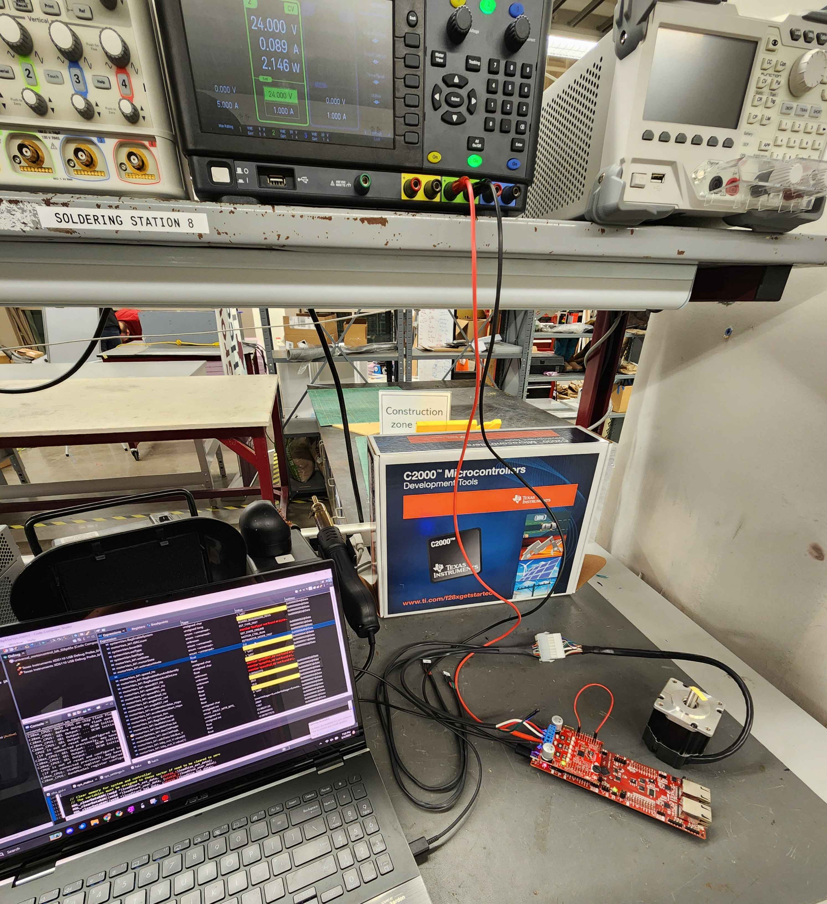
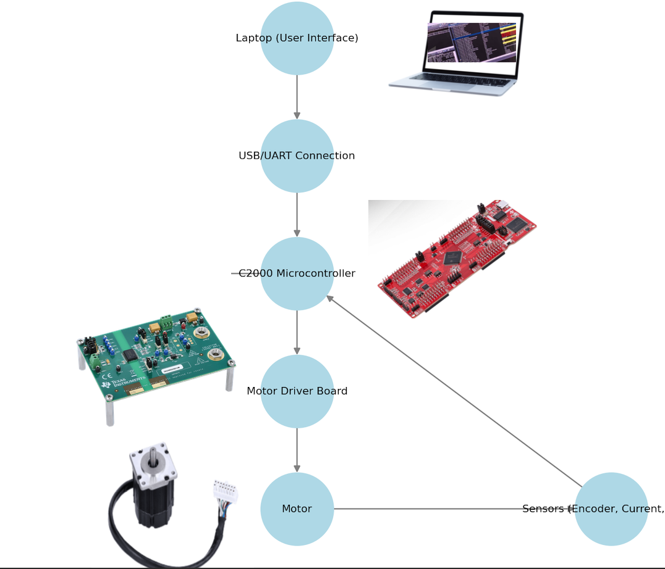
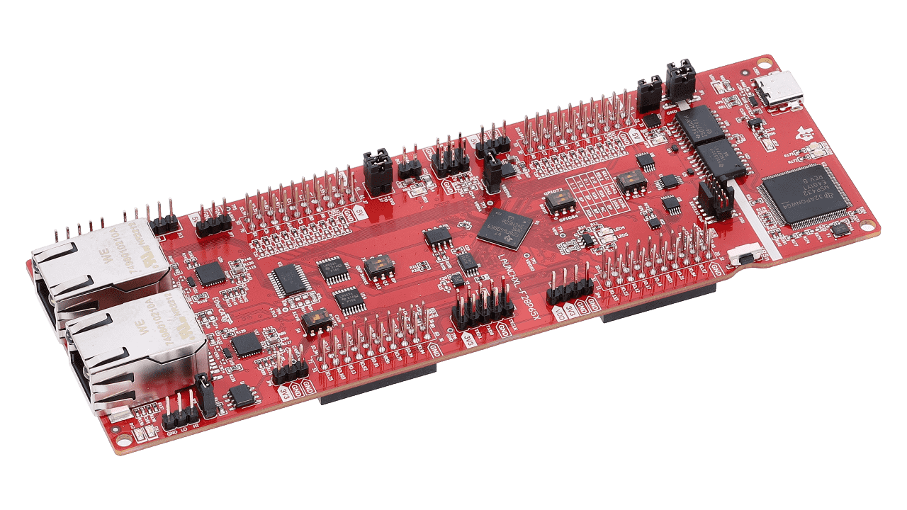
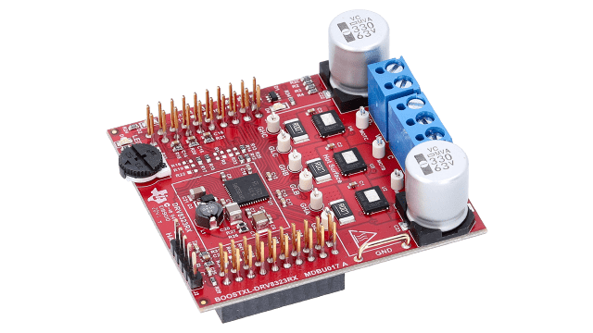
Integrated System Diagram
Notes:
Eric

Slide 4
Project Timeline
Port motor control solution to F28P65x Board [full system integration] (completed 1/30) | Modify software to enable data capture (to complete by 2/20) | Modify software for ADC resolution (12/16) bit (to complete by 3/6) | Modify software to run using 32/64 bit floating point (to complete by 3/6) | Modify software to enable oversampling (to complete by 3/6) | Test full software compatibility after updates (to complete by 3/24) | Full system Validation/ testing (to complete by 3/27) | Demo and Report (to complete by 4/21)
Notes:
Eric

Slide 5
Oversampling
Tamara
Accomplishments since last update 20 hrs of effort | Ongoing progress/problems and plans until the next presentation
Successfully Integrated Oversampling into the Full Motor Control Software (compiles and runs with no errors) Offloaded summation to hardware to reduce CPU overhead and improve real-time performance | Performance Benchmarking Ensure system maintains required timing constraints under varying loads Edge Case Testing

Slide 6
12/16 Bit ADC Resolution
Cristian
Accomplishments since last update 19 hrs of effort | Ongoing progress/problems and plans until the next presentation
The ADC voltages are actively updating (16-bit). The sensorless motor spins while running on 16-bit ADC resolution. | Last Obstacle: The ADC bus voltage shows 1V instead of the 24V that that DC power supply supplies. I will run the sensorless motor implementing both 12 and 16 bit ADC resolution and compare the performance between the two resolutions.

Slide 7
Float 64 Operation
Case King
Accomplishments since last update 18 hrs of effort | Ongoing progress/problems and plans until the next presentation
Code Compiles without errors. Code will run on the board. Motor will operate at 60 Hz correctly. | There is a problem in the ADC that causes a misreading of the voltage and current, leading to the system to detect a fault and cease function.

Slide 8
Test Data Acquisition
Tyler Hawkins
Accomplishments since last update 23 hrs of effort | Ongoing progress/problems and plans until the next presentation
-Set up UART framework and gathered all necessary libraries within CCS -Finished the final tweaks on motor mount | -Cannot get UART working, Including Device examples. -Fix problem with UART connection and begin gathering Configuration Test Data

Slide 9
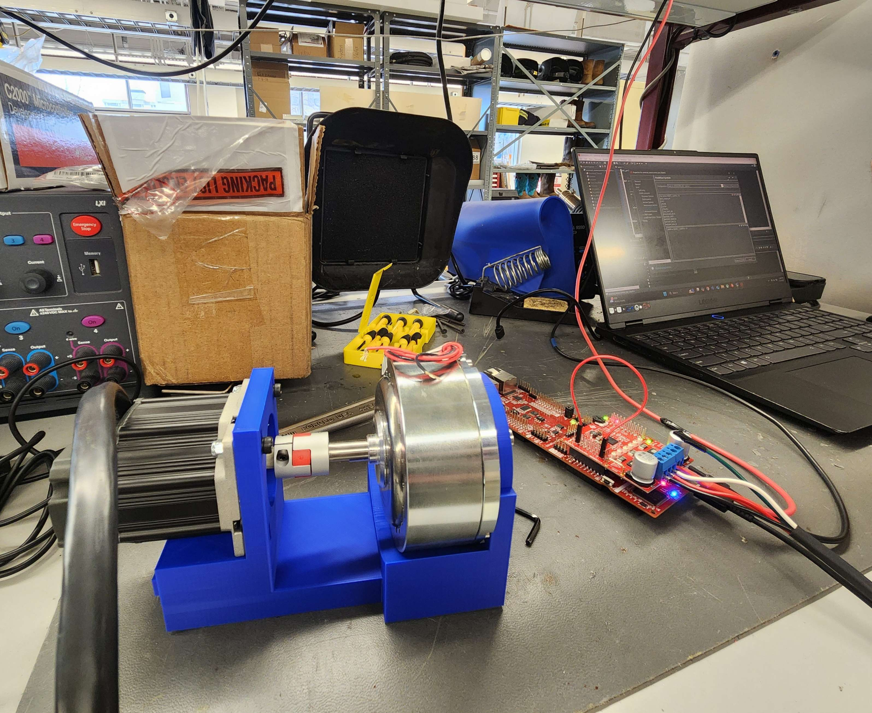

Slide 10
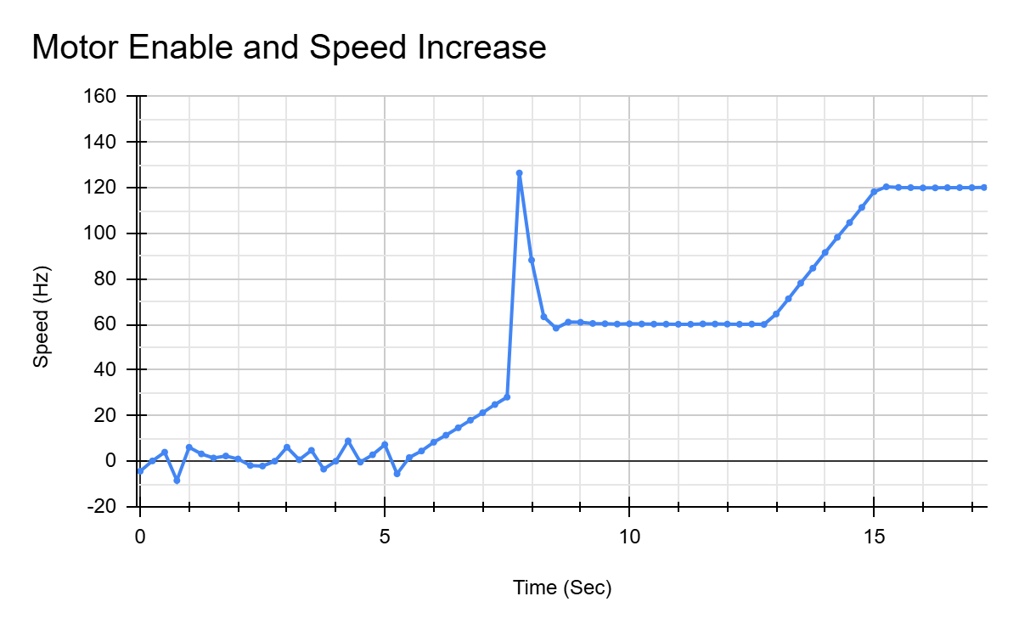

Slide 11
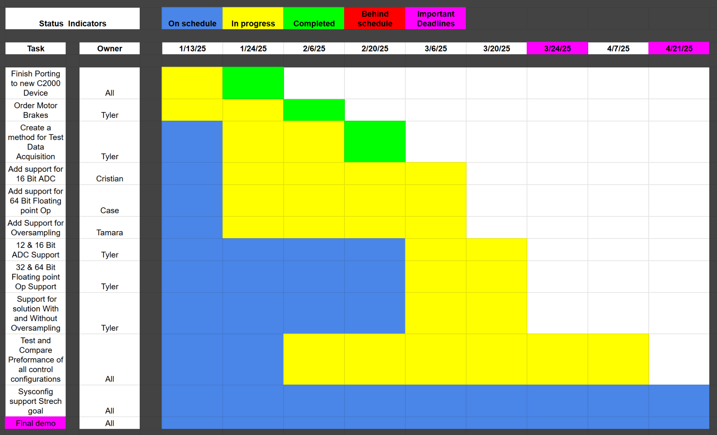
Execution Plan
Notes:
Michelle

Slide 12
Validation Plan
Task | Specification | Result | Owner
Porting Solution onto F28p65x board (requirement #1) | Ported motor control software onto f28p65x board successfully according to the Universal Motor control guide | PASSED | All
16 Bit ADC resolution (requirement #2) | The system correctly operates using 16-bit ADC resolution according to The Universal Motor control guide | Some Issues | Cristian
64-bit Floating point operation (requirement #4) | The system Correctly Operates using 64-bit Floating Point according to The Universal Motor control guide | Some Issues | Case
Enable oversampling (requirement #3) | The system Correctly Operates while oversampling is enabled according to The Universal Motor control guide | UNTESTED | Tamara
12 Bit & 16 Bit ADC resolution Support (requirement #2) | The system correctly operates using either 12-bit or 16-bit ADC resolutions according to The Universal Motor control guide | Passed | Cristian

Slide 13
Validation Plan
Task | Specification | Result | Owner
32-bit & 64-bit Floating point operation (requirement #4) | The system Correctly Operates using either 32-bit or 64-bit Floating Point according to The Universal Motor control guide | Passed | Tyler
Test data acquisition (requirement #5) | The system Correctly gathers test data for the following parameters: speed ripple, speed step, and load step. Able to be graphed and differences should be able to be seen. | Passed But Needs Improvements | Tyler
Test 12 vs 16 Bit performance (requirement #5) | Test the performance of 12-bit and 16-bit ADC resolutions: speed ripple, speed step, load step. | UNTESTED | Cristian
Test 32-bit & 64-bit Floating-point performance (requirement #5) | Test the performance of 32-bit and 64-bit ADC Floating point operations: speed ripple, speed step, load step. | UNTESTED | Case
Test the performance of oversampling (requirement #5) | Test the effectiveness of oversampling: speed ripple, speed step, load step. | UNTESTED | Tamara

Slide 14
Thanks & Gig’em
Team 1: ADC Resolution vs. Sensorless Motor Control Performance

